Slide 1
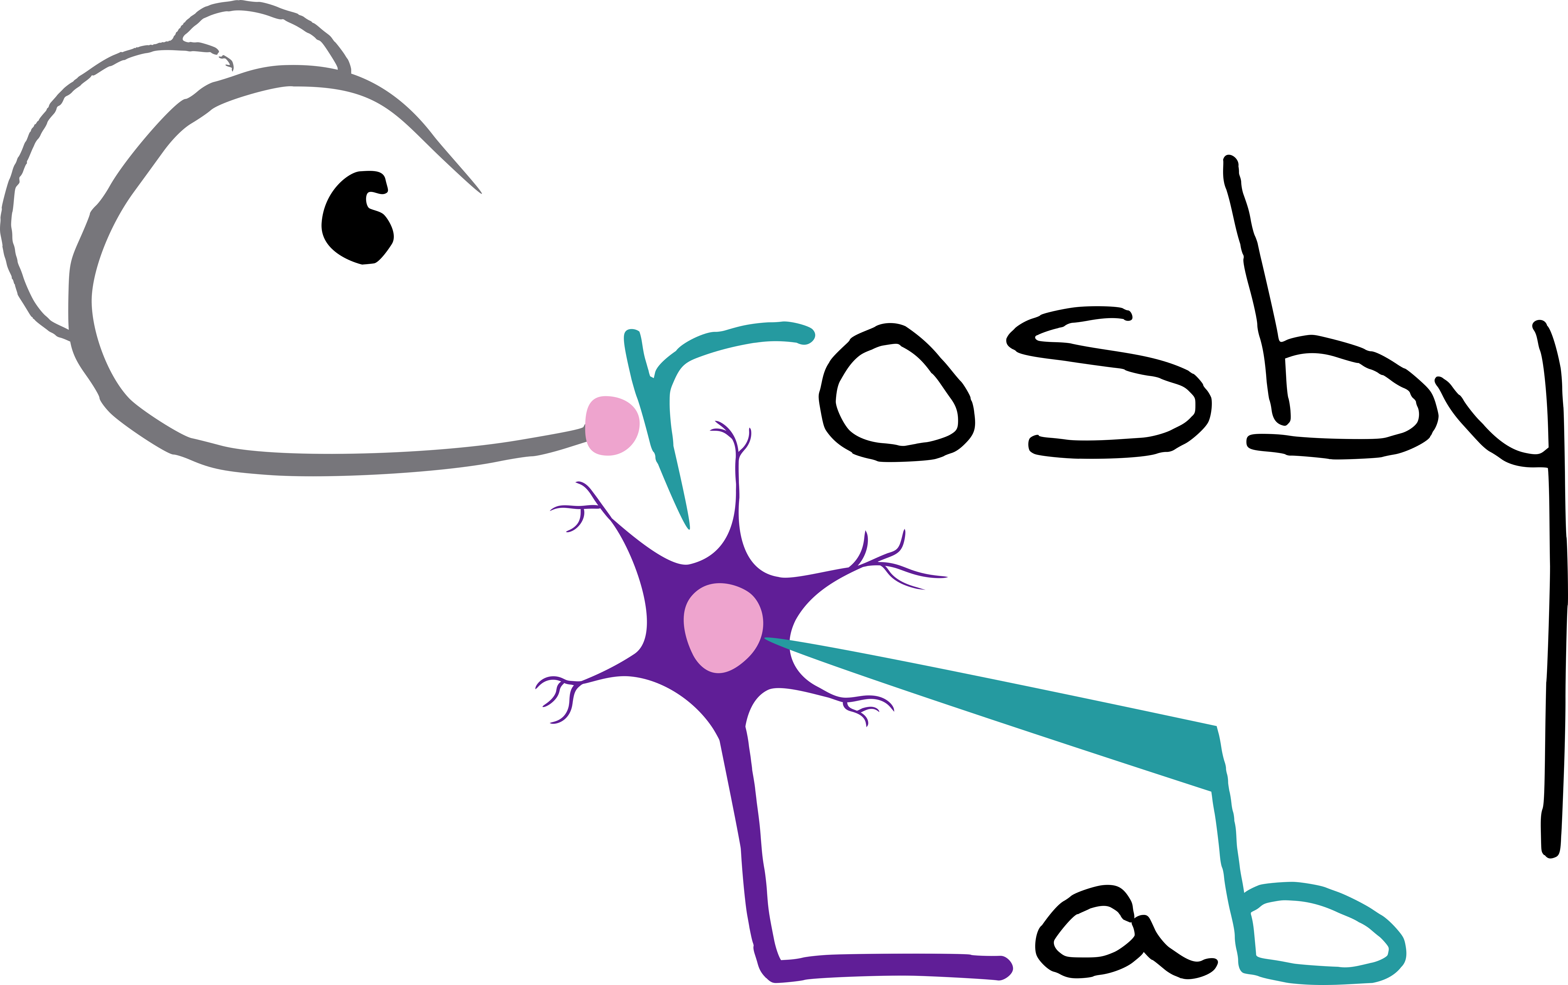


The effect of acute and repeated stress on excitatory neurons in the female rat dorsomedial hypothalamus
Ruby Muzzatti, Dr Karen Crosby
Department of Biology, Mount Allison University, Sackville, New Brunswick
Notes:
Need NBIF?

Slide 2
Background
Modern food landscape
high calorie
highly palatable
ultra-processed
High obesity rates in New Brunswick
Evidence of sex differences in food intake under chronic stress but what about acute stress?
Notes:
VERY COMPLEX but there is evidence in chronic stress, so what about acute stress, and what is the neurophysiological basis of this?

Slide 3
Acute stress
Hypothalamic-Pituitary-Adrenal Axis
Sympathetic
Nervous
System
Norepinephrine ↓ appetite
Epinephrine ↓ appetite
CRH ↓ appetite
ACTH
Cortisol ↑ appetite
Notes:
Let’s think about what we know about acute stress and appetite
So, there is a delicate balance between the hunger provoking HPA and the hunger suppressing SNS
Generally, this balance works the decrease hunger during an acute stressor

Slide 4
Repeated stress

Slide 5
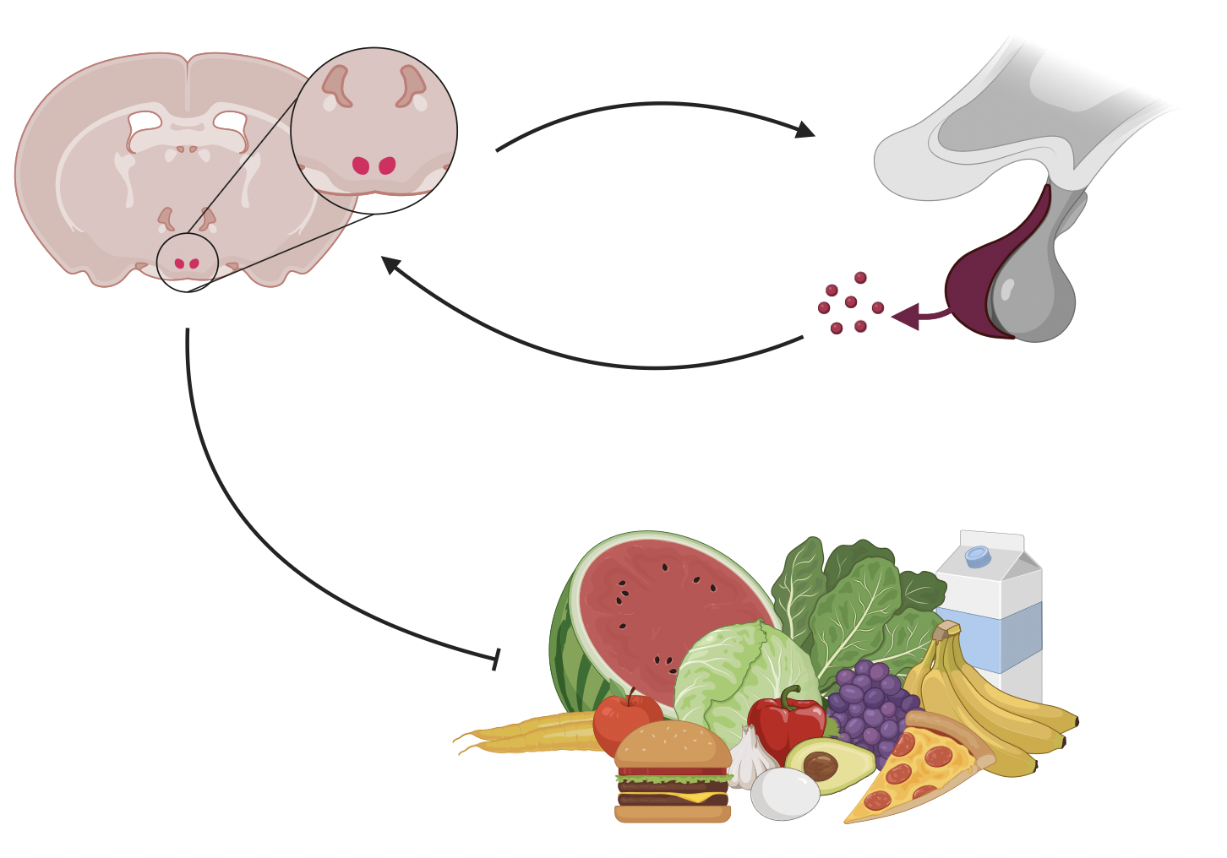
Why study the DMH?
Notes:
The DMH is involved in a lot of processes, including regulation of heart rate during stress, thermoregulation, and super importantly the regulation of appetite and body weight
Remember those glucocorticoid receptors?

Slide 6
Why study the DMH?
Notes:
The DMH is involved in a lot of processes, including regulation of heart rate during stress, thermoregulation, and super importantly the regulation of appetite and body weight
Remember those glucocorticoid receptors?

Slide 7
Why study the DMH?
Notes:
The DMH is involved in a lot of processes, including regulation of heart rate during stress, thermoregulation, and super importantly the regulation of appetite and body weight
Remember those glucocorticoid receptors?

Slide 8
Why study the DMH?
Notes:
The DMH is involved in a lot of processes, including regulation of heart rate during stress, thermoregulation, and super importantly the regulation of appetite and body weight
Remember those glucocorticoid receptors?

Slide 9
Does acute stress and repeated stress affect glutamatergic neurons in the DMH of young female rats? If so, by what mechanism?
Notes:
Hypothesis: acute stress will alter neuronal excitability and communication in the DMH
Prediction: acute stress will decrease transmission of glutamate and activity of DMH neurons

Slide 10
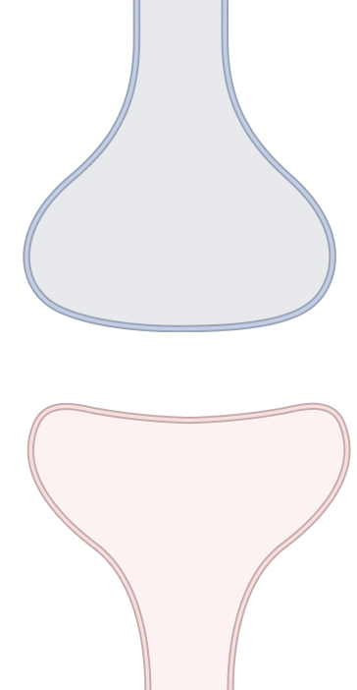
Presynaptic neuron
Nervous System Basics
Postsynaptic neuron
Notes:
The nervous system uses chemical (neurotransmitter) and electrical signals to communicate
Electrical stimulation comes down, NT releases from the presynaptic neuron into the synaptic cleft, and then those NT make the postsynaptic neuron more or less likely to fire an action potential for this to continue

Slide 11
Presynaptic neuron
Nervous System Basics
Electrical
Postsynaptic neuron
Notes:
The nervous system uses chemical (neurotransmitter) and electrical signals to communicate
Electrical stimulation comes down, NT releases from the presynaptic neuron into the synaptic cleft, and then those NT make the postsynaptic neuron more or less likely to fire an action potential for this to continue

Slide 12
Presynaptic neuron
Nervous System Basics
Electrical
Neurotransmitter
Postsynaptic neuron
Notes:
The nervous system uses chemical (neurotransmitter) and electrical signals to communicate
Electrical stimulation comes down, NT releases from the presynaptic neuron into the synaptic cleft, and then those NT make the postsynaptic neuron more or less likely to fire an action potential for this to continue

Slide 13
Presynaptic neuron
Nervous System Basics
Electrical
Neurotransmitter
Postsynaptic neuron
Notes:
The nervous system uses chemical (neurotransmitter) and electrical signals to communicate
Electrical stimulation comes down, NT releases from the presynaptic neuron into the synaptic cleft, and then those NT make the postsynaptic neuron more or less likely to fire an action potential for this to continue

Slide 14
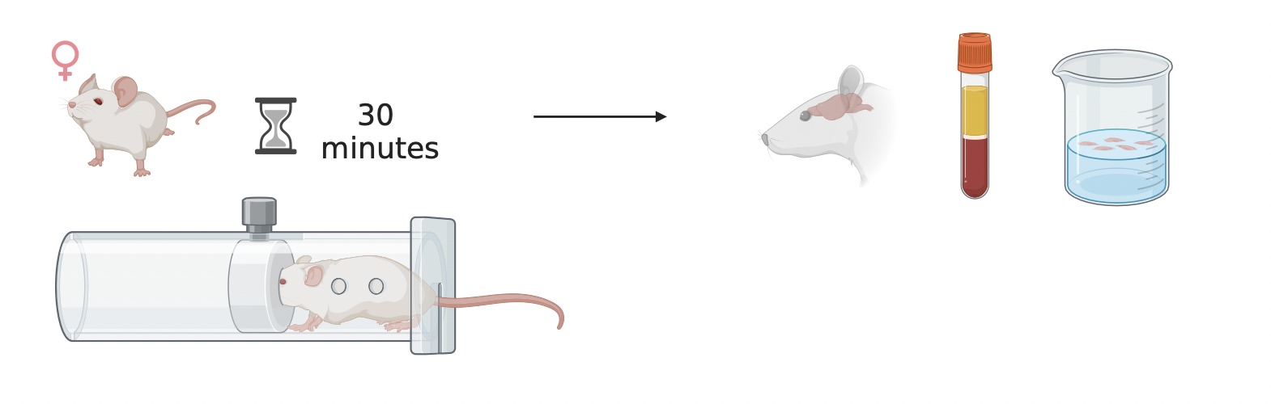
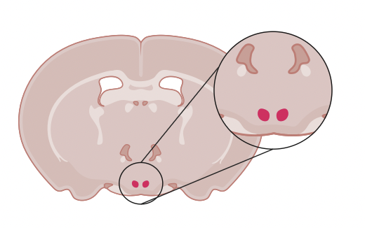
Methods: Stress

Slide 15
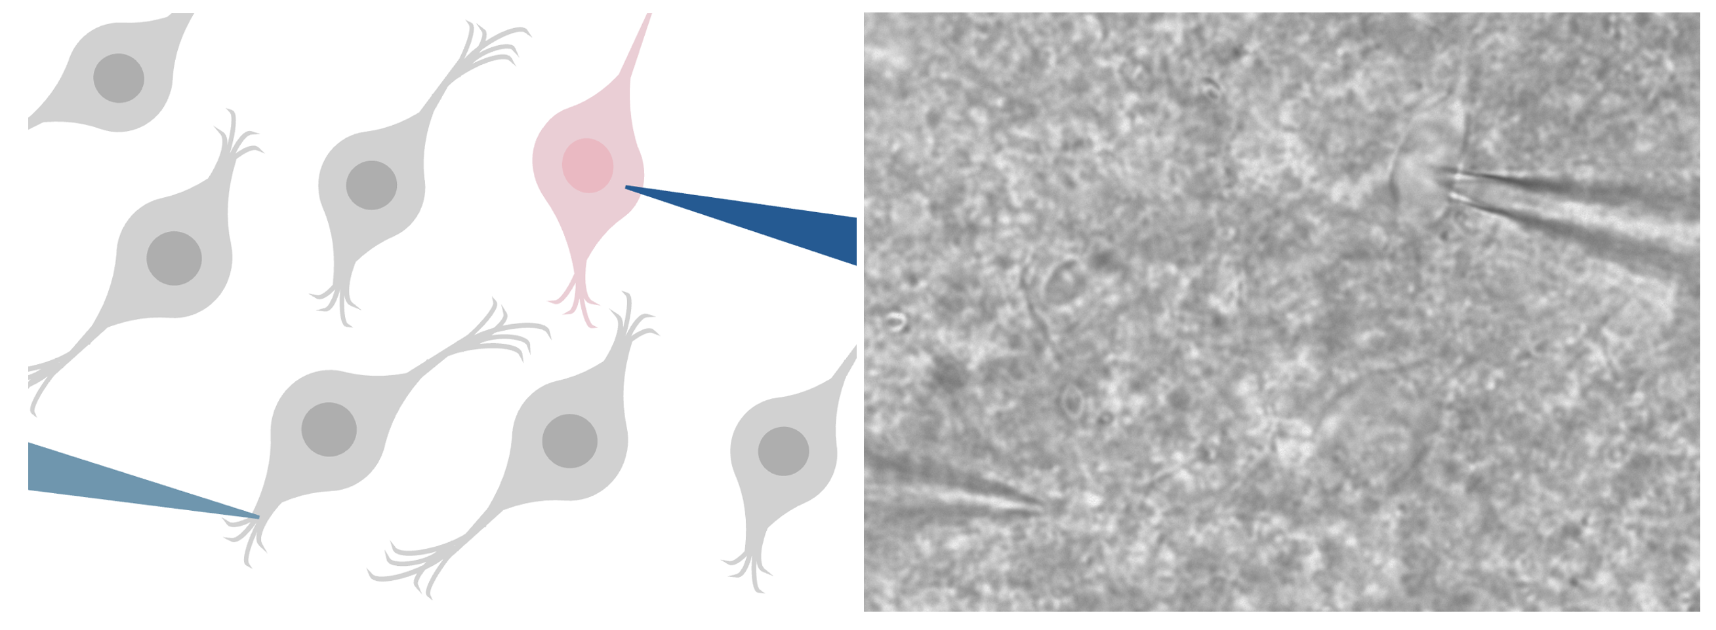
Methods: Recording from living neurons
Postsynaptic neuron
Presynaptic neuron

Slide 17
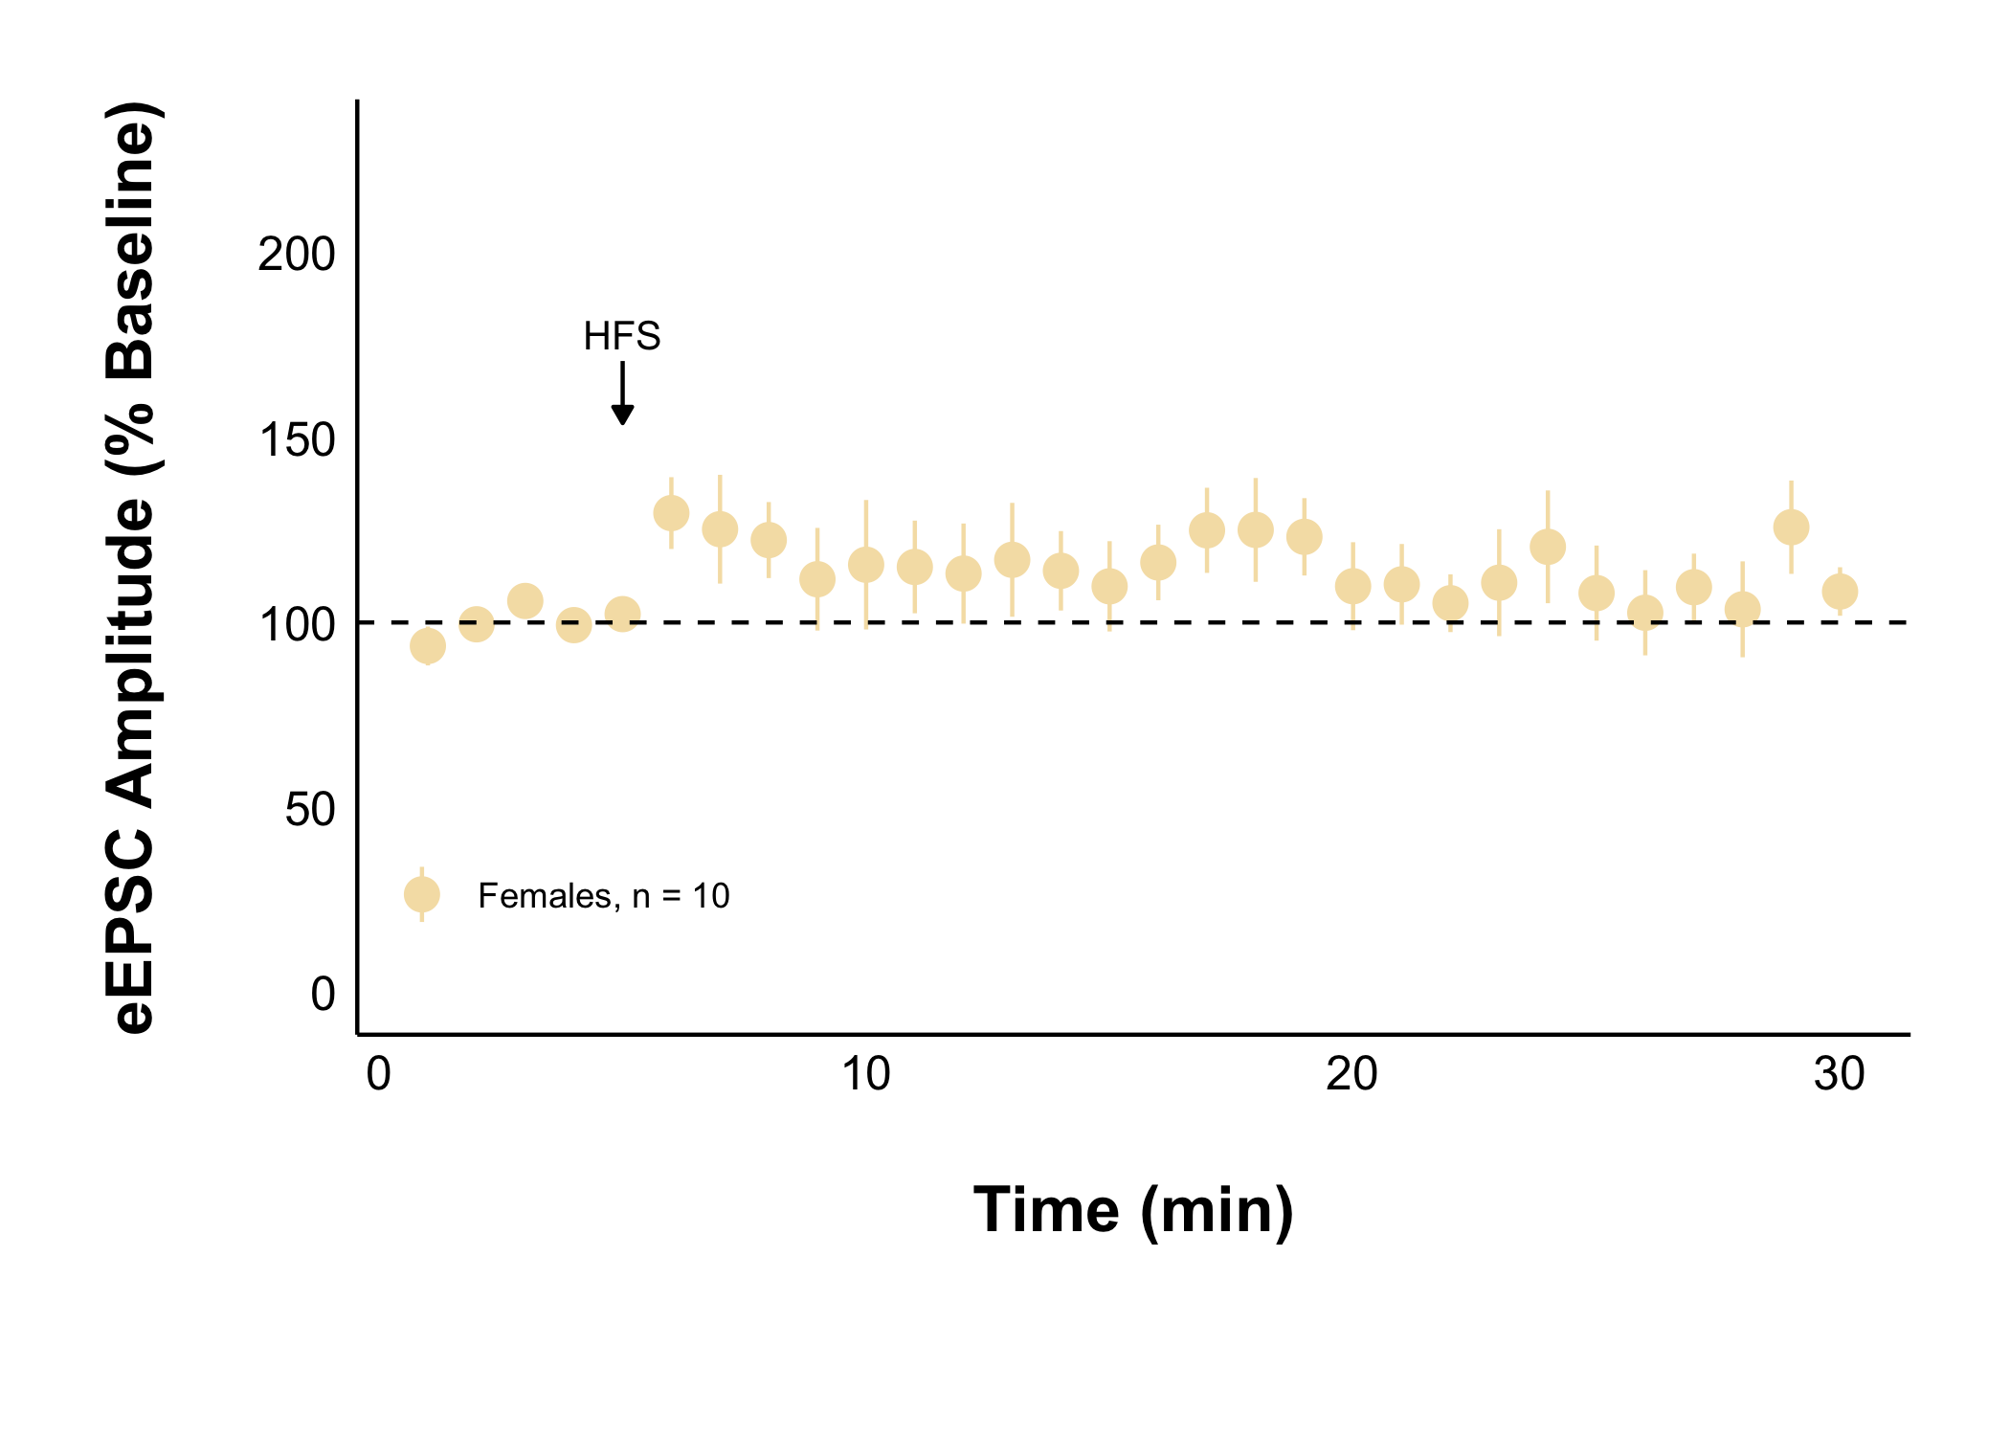
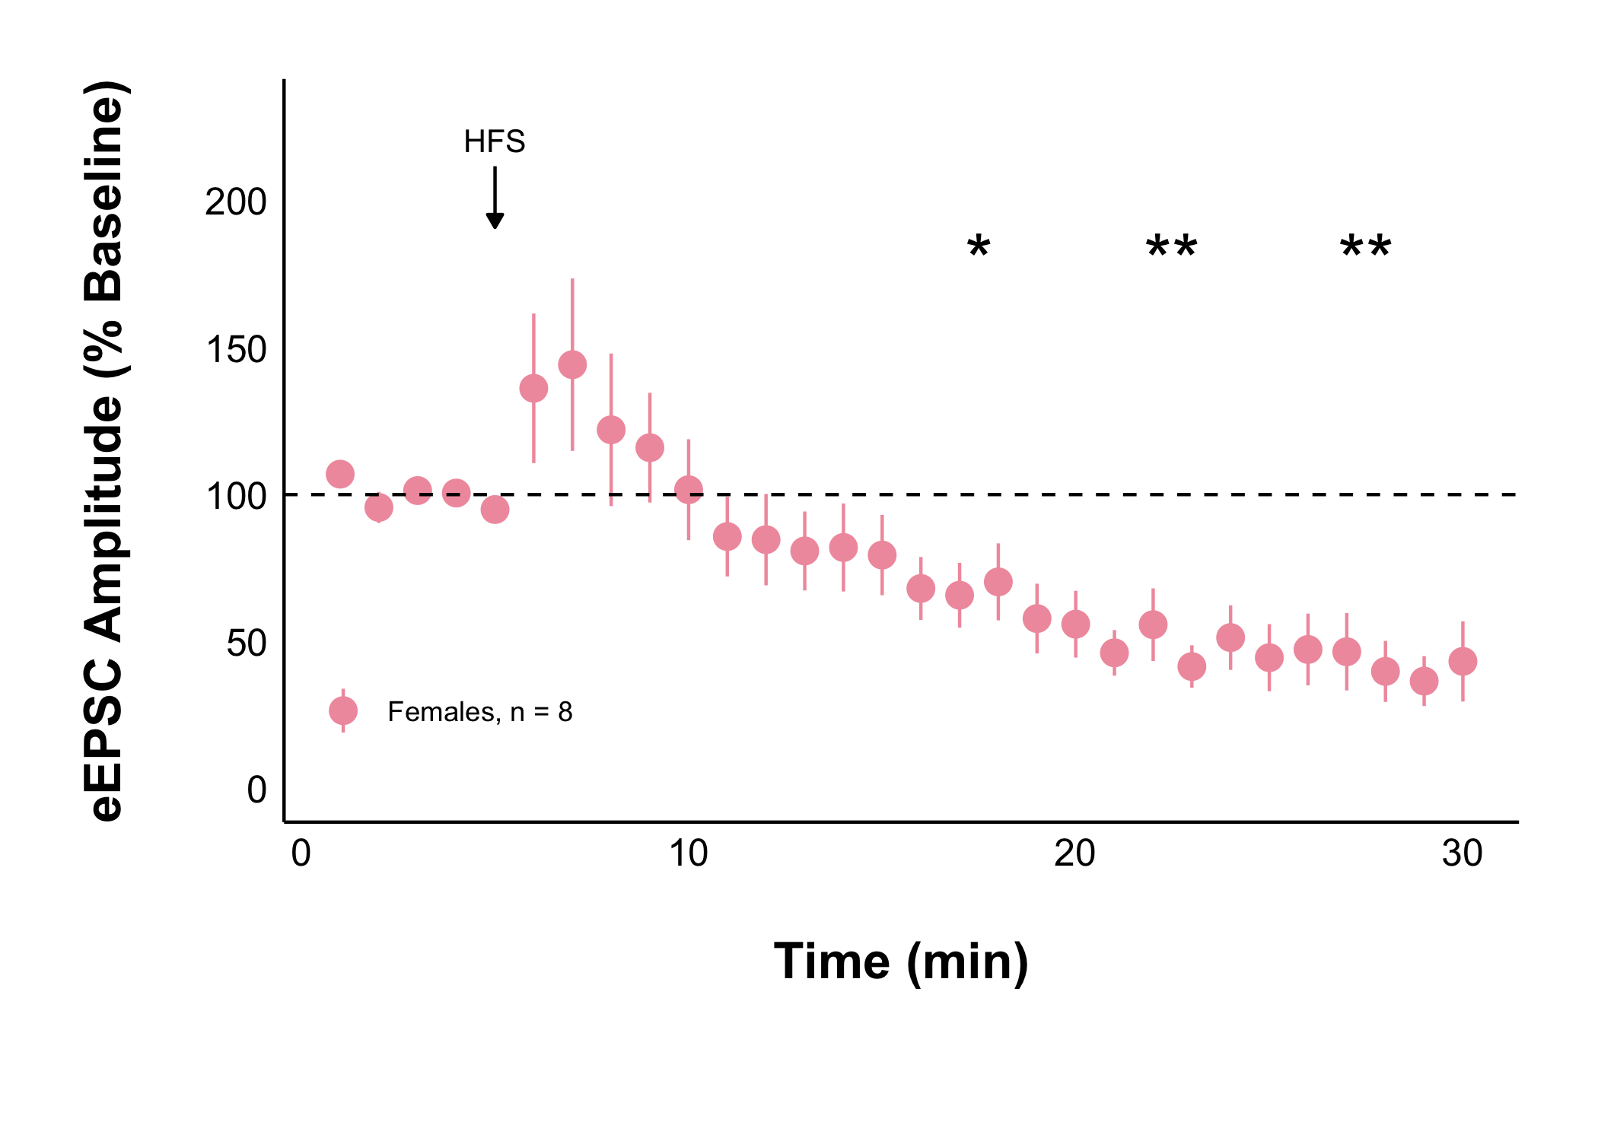
Naïve + Control Treatment
Acute Stress + Control Treatment
Acute stress decreases evoked excitatory current amplitude after HFS

Slide 18
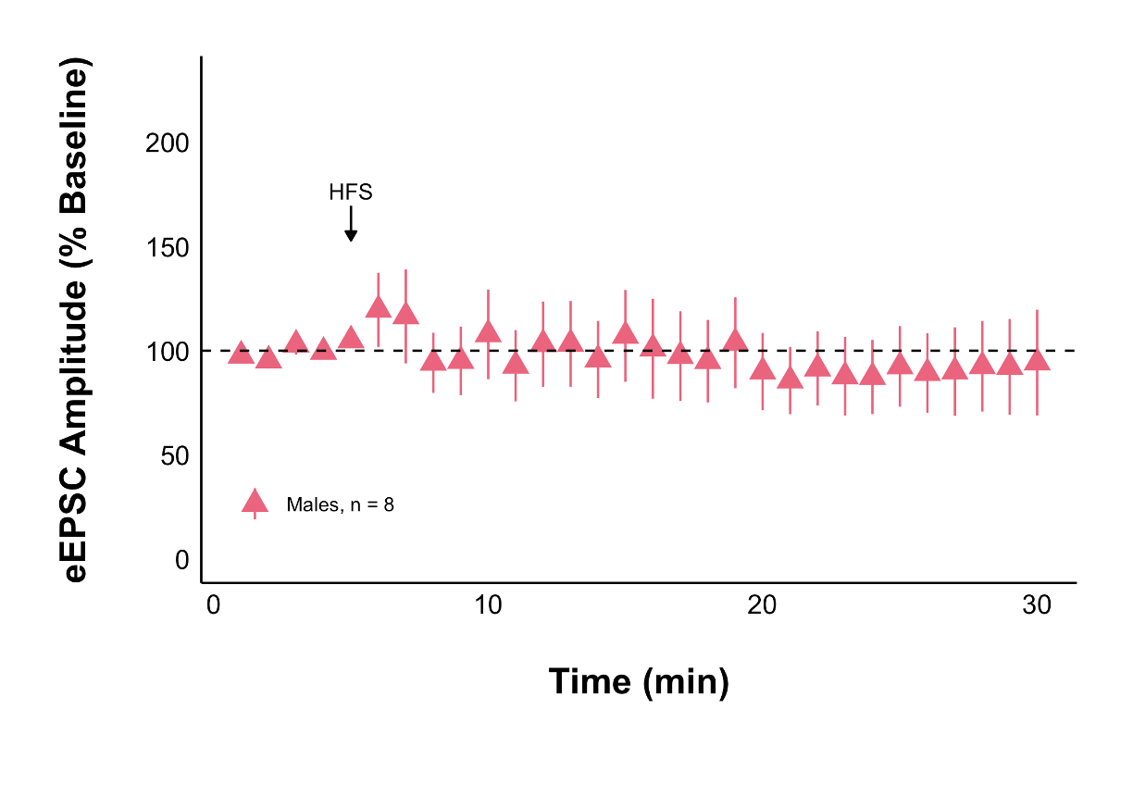
Acute Stress + Control Treatment
Acute Stress + Control Treatment
Acute stress decreases evoked excitatory current amplitude after HFS in females but not males
Notes:
So then we wanted to know if that decreased amplitude of response to glutamate is because of a presynaptic change in glutamate release – that is: is the presynaptic neuron releasing less gluatamte?

Slide 19
Why does acute stress decrease the strength of glutamate synapses?

Slide 20
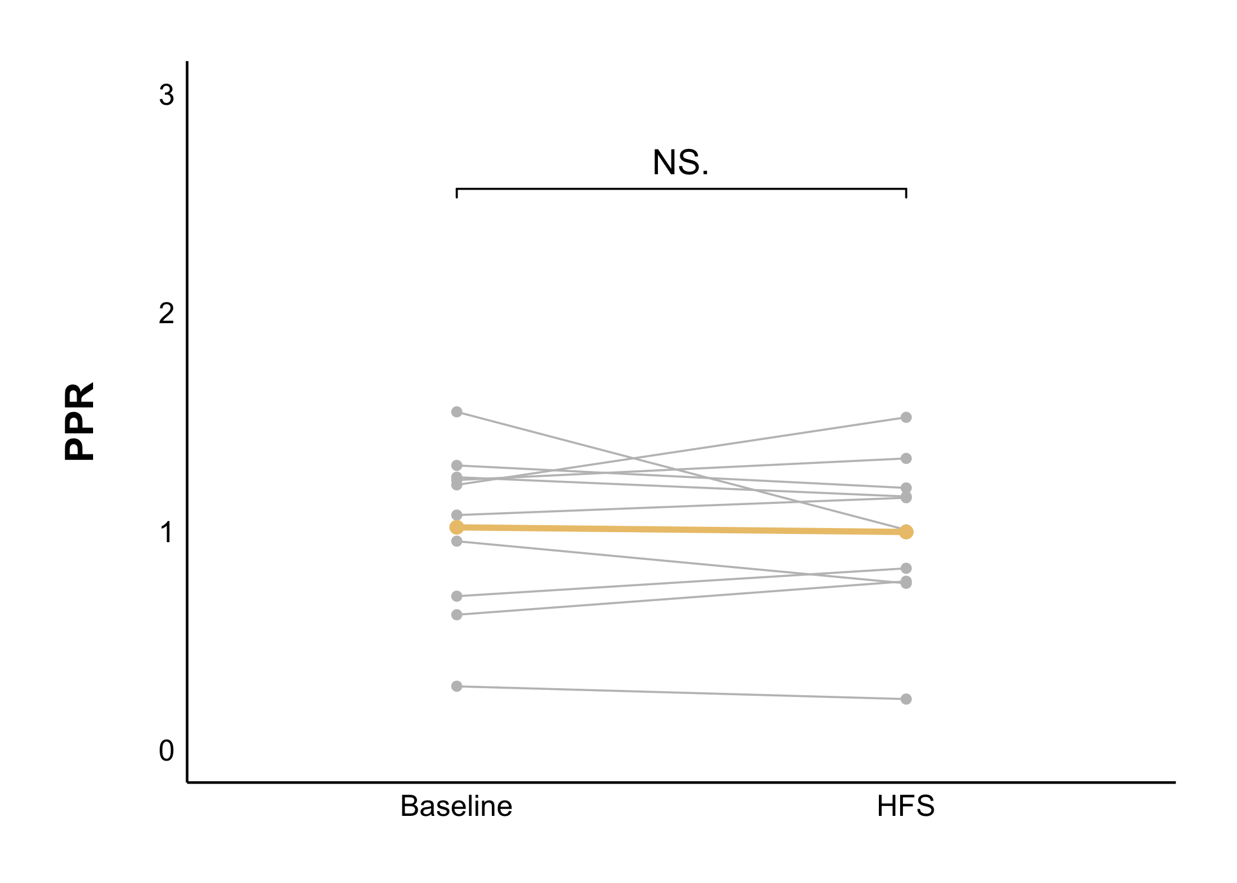
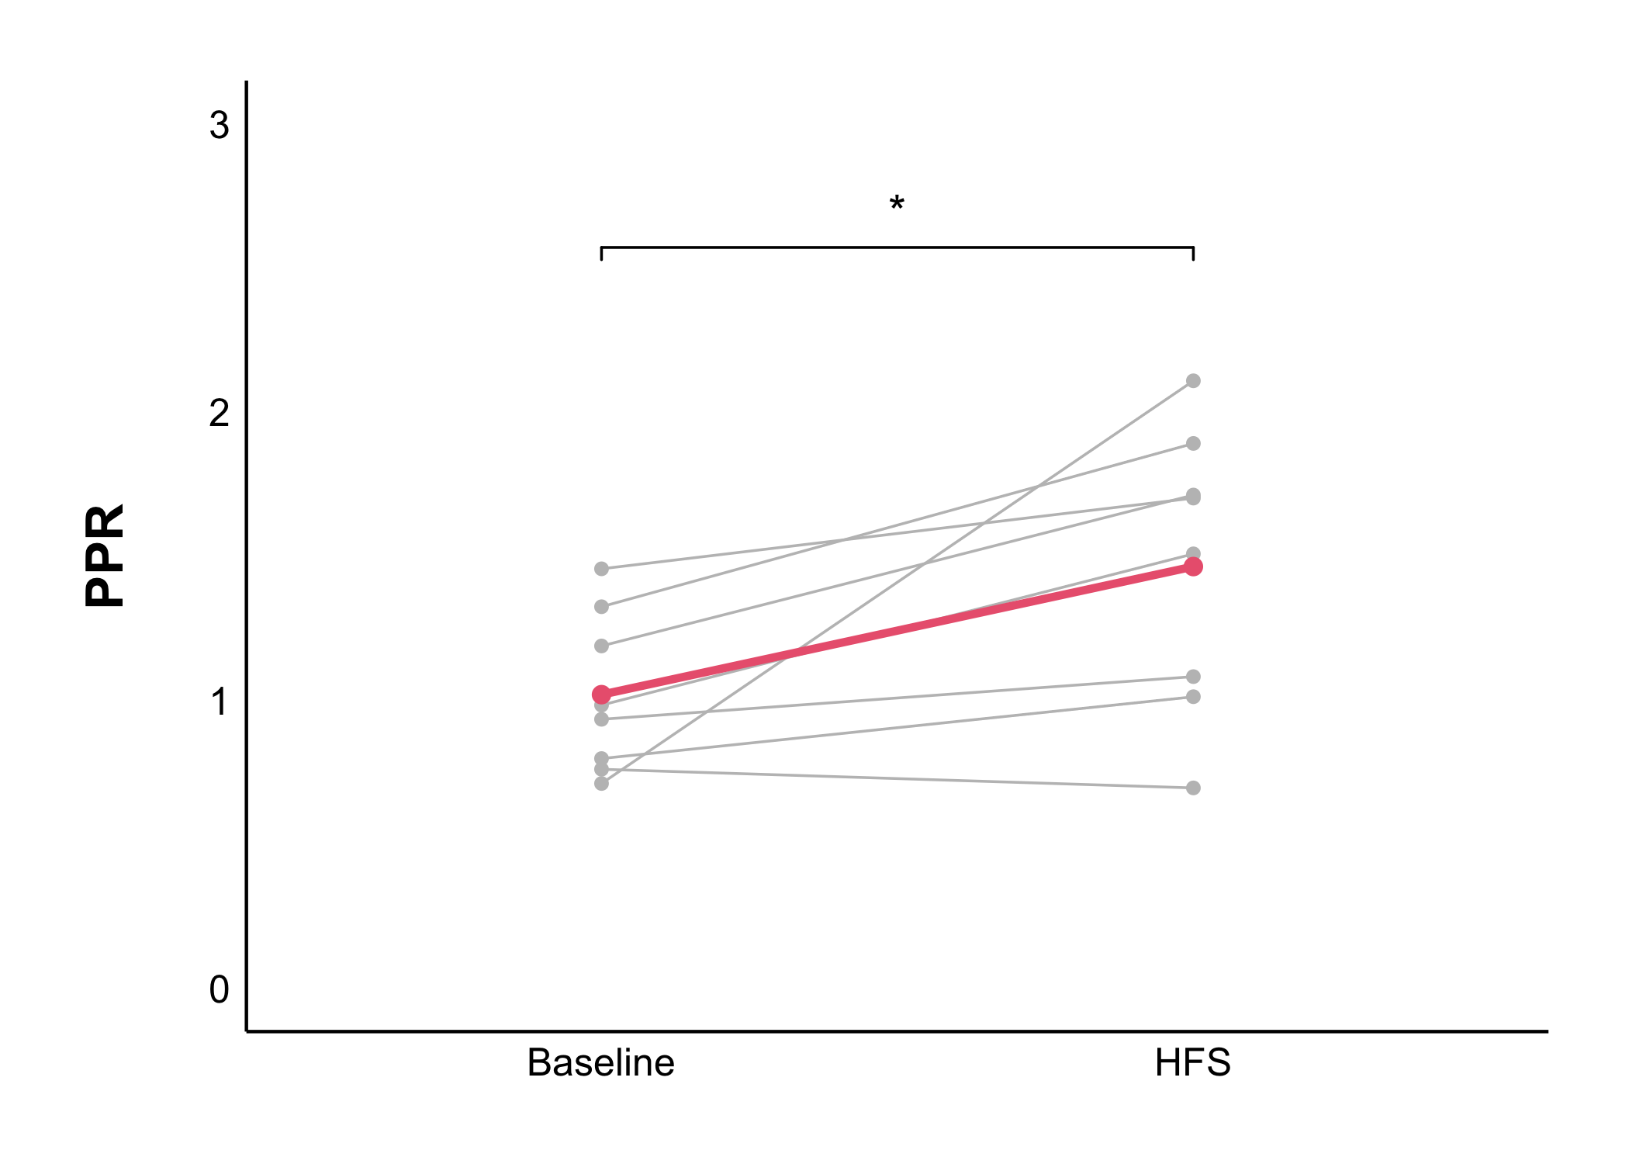
Naïve + Control Treatment
Acute Stress + Control Treatment
Acute stress presynaptically decreases the probability of glutamate release after HFS
Notes:
YES

Slide 21
What is causing the presynaptic decrease in glutamate transmission seen under acute stress?

Slide 22
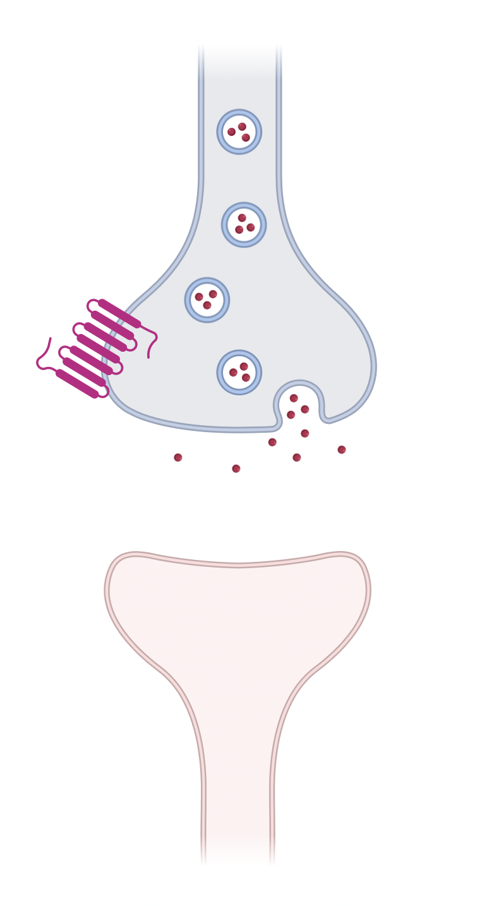
Notes:
RETROGRADE SIGNALLING
THIS IS WHAT NORMALLY HAPPENS AS PART OF CORTISOL’S NEGATIVE FEEDBACK
We know this happens in CRH neurons in the PVN
Is this what is happening in our DMH neurons?

Slide 23
1. Cortisol binds to glucocorticoid receptors
Notes:
RETROGRADE SIGNALLING
THIS IS WHAT NORMALLY HAPPENS AS PART OF CORTISOL’S NEGATIVE FEEDBACK
We know this happens in CRH neurons in the PVN
Is this what is happening in our DMH neurons?

Slide 24
2. Endocannabinoid (eCB) synthesis increases
1. Cortisol binds to glucocorticoid receptors
Notes:
RETROGRADE SIGNALLING
THIS IS WHAT NORMALLY HAPPENS AS PART OF CORTISOL’S NEGATIVE FEEDBACK
We know this happens in CRH neurons in the PVN
Is this what is happening in our DMH neurons?

Slide 25
3. eCBs travel backwards and activate CB1Rs
2. Endocannabinoid (eCB) synthesis increases
1. Cortisol binds to glucocorticoid receptors
Notes:
RETROGRADE SIGNALLING
THIS IS WHAT NORMALLY HAPPENS AS PART OF CORTISOL’S NEGATIVE FEEDBACK
We know this happens in CRH neurons in the PVN
Is this what is happening in our DMH neurons?

Slide 26
4. Activation of CB1Rs inhibits glutamate release
3. eCBs travel backwards and activate CB1Rs
2. Endocannabinoid (eCB) synthesis increases
1. Cortisol binds to glucocorticoid receptors
Notes:
RETROGRADE SIGNALLING
THIS IS WHAT NORMALLY HAPPENS AS PART OF CORTISOL’S NEGATIVE FEEDBACK
We know this happens in CRH neurons in the PVN
Is this what is happening in our DMH neurons?

Slide 27
4. Activation of CB1Rs inhibits glutamate release
3. eCBs travel backwards and activate CB1Rs
2. Endocannabinoid (eCB) synthesis increases
1. Cortisol binds to glucocorticoid receptors
Notes:
RETROGRADE SIGNALLING
THIS IS WHAT NORMALLY HAPPENS AS PART OF CORTISOL’S NEGATIVE FEEDBACK
We know this happens in CRH neurons in the PVN
Is this what is happening in our DMH neurons?

Slide 28
Naïve + Control Treatment
Acute Stress + Control Treatment
Acute stress decreases evoked excitatory current amplitude after HFS

Slide 29
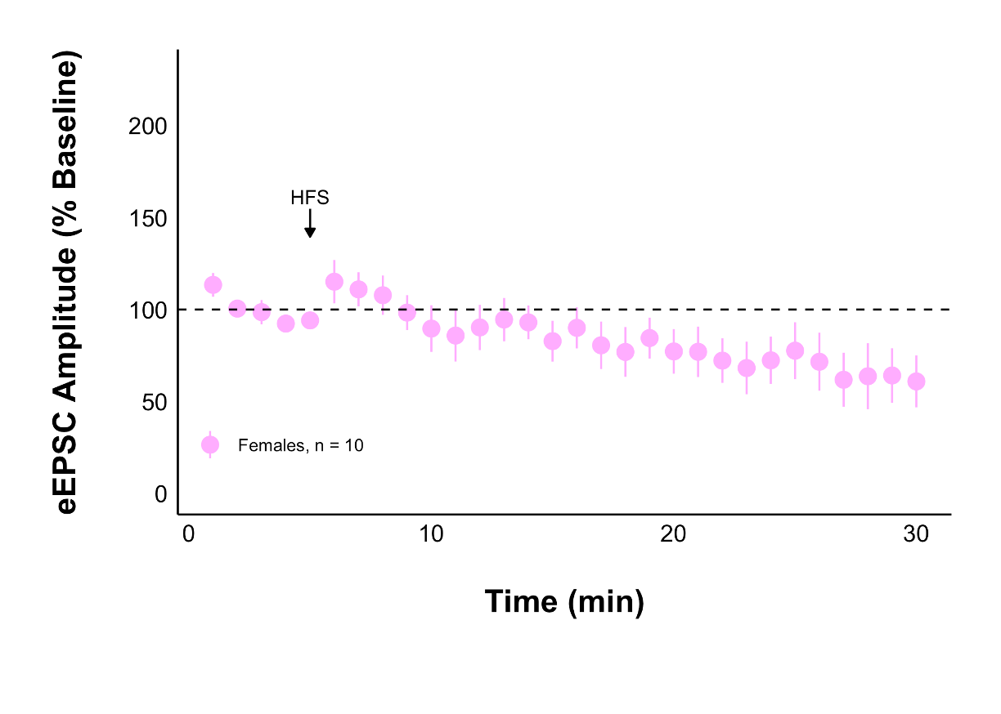
Acute Stress + AM251
Acute Stress + Control Treatment
Glutamate transmission did not decrease when CB1Rs were blocked
Notes:
AM251 is a blocker of CB1 receptors, which are part of the endocannabinoid system

Slide 30
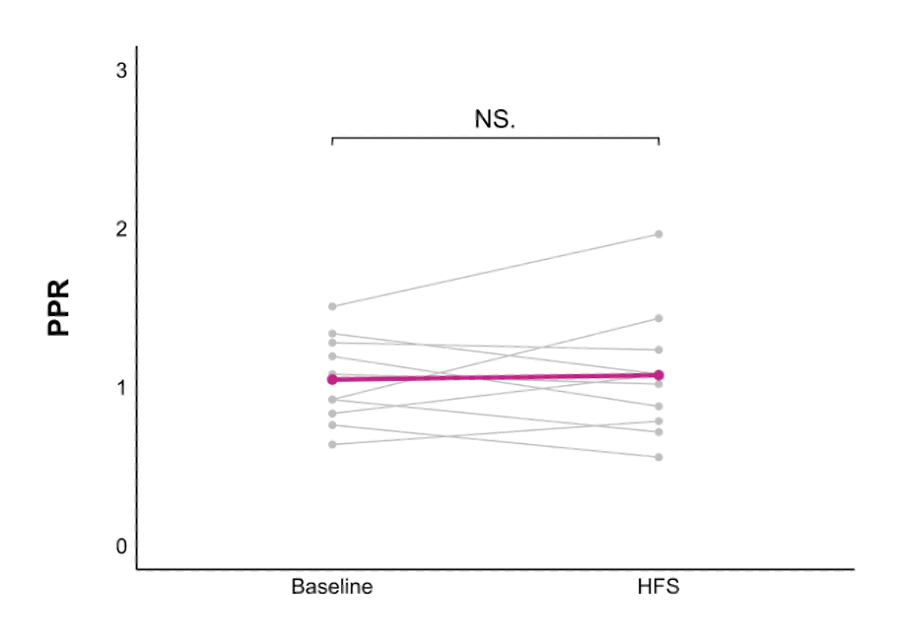
Acute Stress + AM251
Acute Stress + Control Treatment
The decrease in presynaptic glutamate release was not seen when CB1Rs were blocked
Notes:
YES

Slide 31
Conclusion
Acute stress
decreases amplitude of excitatory currents
decreases presynaptic glutamate release
in DMH neurons
The endocannabinoid CB1 receptor mediates these changes

